Slide 1


Riceye
created by : Hansel, Rike, Brizky
bangk!t JKT3-E

Slide 2
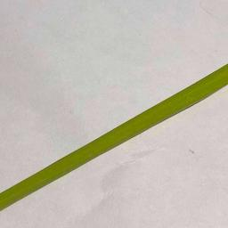
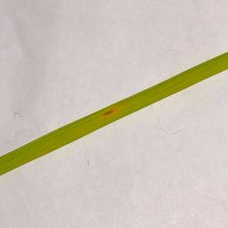
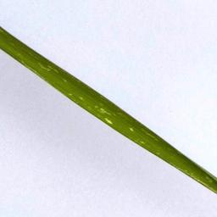
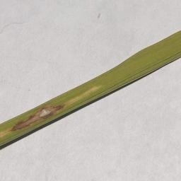
Reason
This dataset has already a quite large numbers of image for training and testing, and besides that the amount of images are already balanced between all the different classes. The dataset also has 3 types of rice diseases which are very common diseases in Southeast Asia, such as Healthy, Brown Spot, Hispa and Leaf Blast which are very worst in our case. The dataset also has a proper work on the image label, so that we also aren’t required to put some extra work in labeling the images.
Healthy
Brown Spot
Hispa
Leaf Blast

Slide 3
Metadata of the dataset
The dataset used for this final project: https://www.kaggle.com/minhhuy2810/rice-diseases-image-dataset
The data is about the In the dataset, there are:
2,000 data which divided into 4 classes:
Brown Spot
Healthy
Hispa
Leaf Blast
So there are 500 data for each class.
Every image has 1362x1362 pixels resolution and 3 colors channel (RGB)

Slide 4
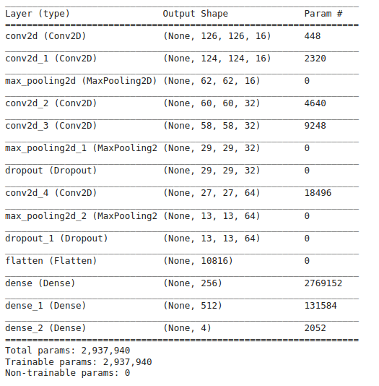
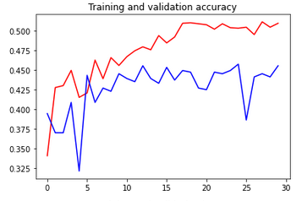
Base Implementation
The same dense layer as the Convolutional Neural Network course in the Coursera as our base implementation. With this kind of layers and runs 30 epochs training, lasted for about 1.5 hours, gives us the validation accuracy of 45%.

Slide 5
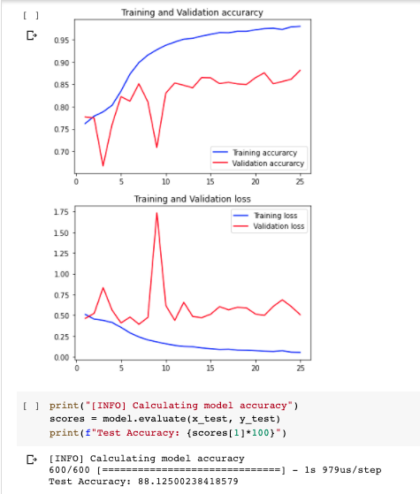
Improvement Implementation
So in order to improve the result, we improve the accuracy of this model by adding more layers and more filters in our convolution. We’re also doing a batch normalization too. Although if we train for another 30 epochs, it’s lasted for about 180 minutes, but it gives us testing accuracy of 87.2%

Slide 6
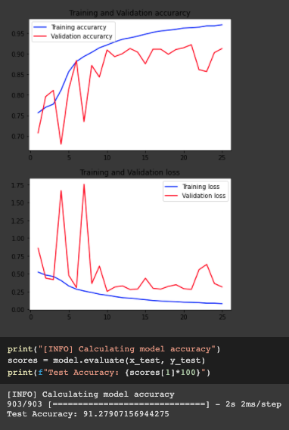
Another Implementation
We noticed that some images in the datasets are wrong classified, so we try to fix that by moving the images to the right class. There are roughly about 300 images that we tweak and the result is pretty significant, we managed to improve our accuracy which is from 87.2% (with the previous dataset) to 91.2%
Link to the New & Improved Dataset:
https://drive.google.com/drive/folders/1lbgXCNdc5BICy-MOzRNdfI670TC-BrnL?usp=sharing

Slide 7
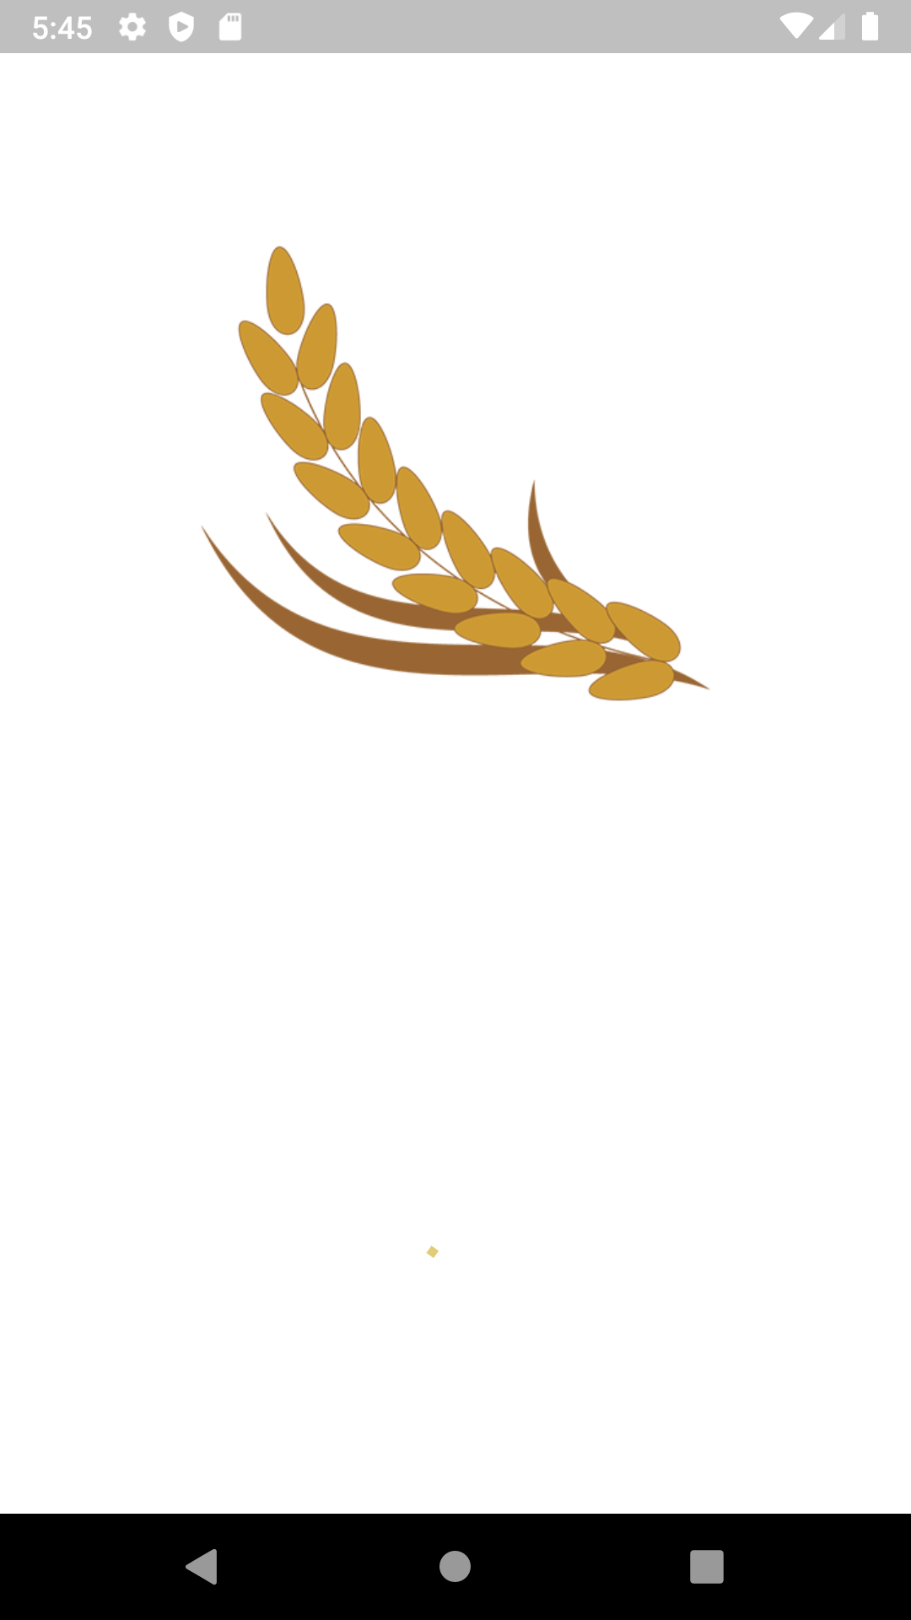
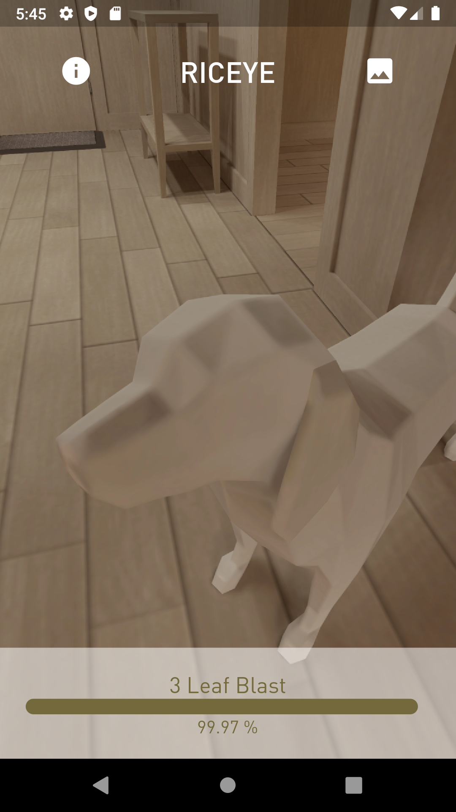
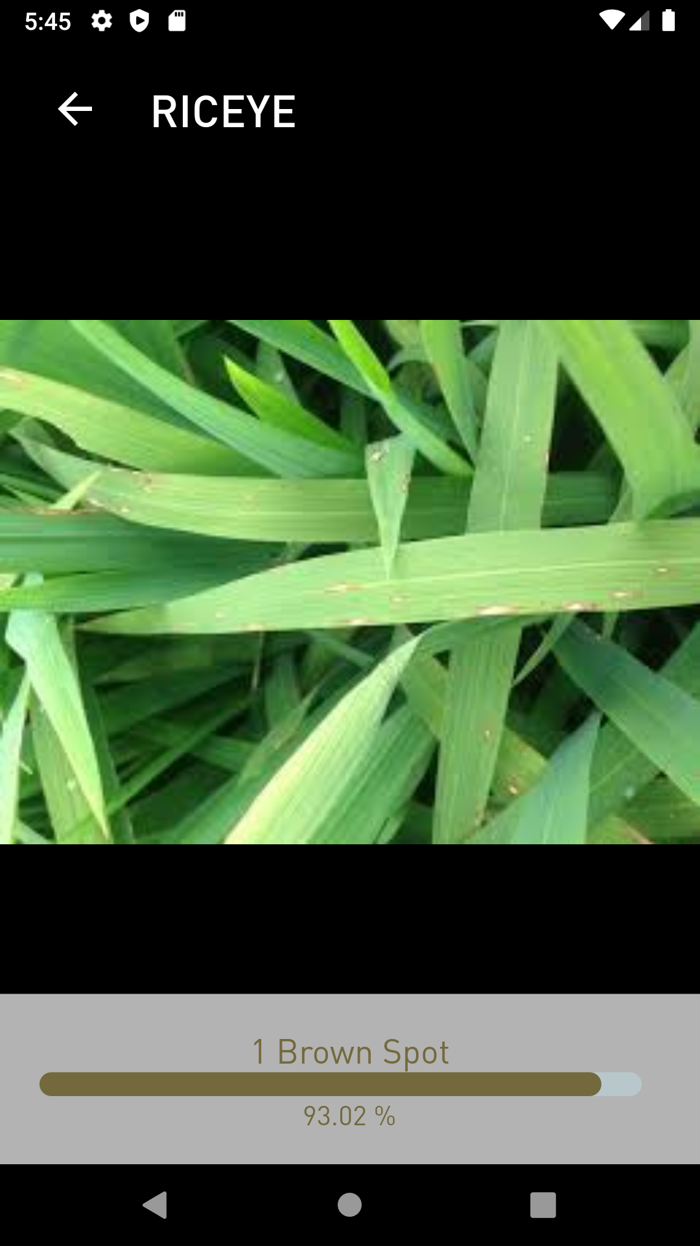
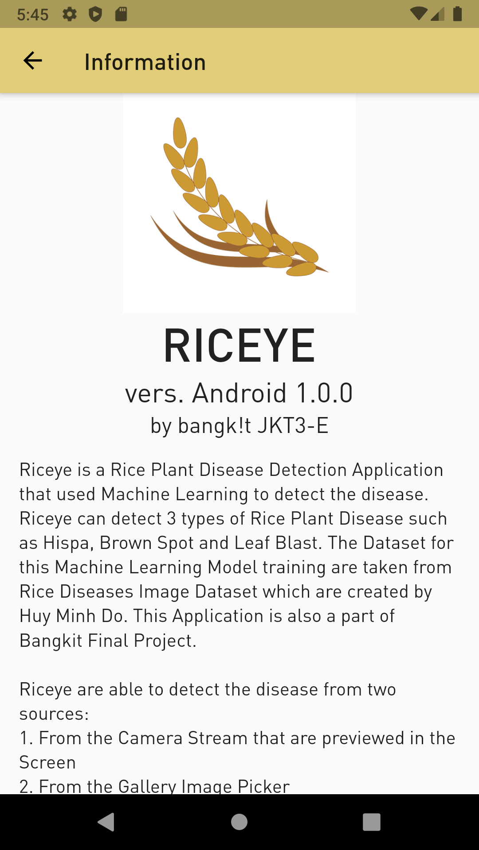
Riceye Mobile App
(It’s should be a leaf)
APP LINK: https://play.google.com/store/apps/details?id=dev.mtsstudio.riceye

Slide 8
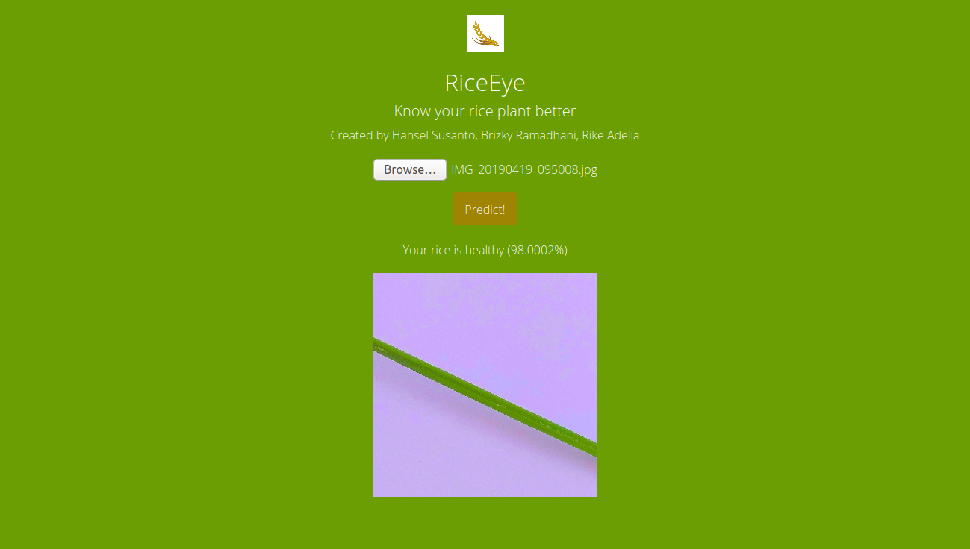
Riceye Web App
WEB LINK: https://riceye.herokuapp.com

Slide 9
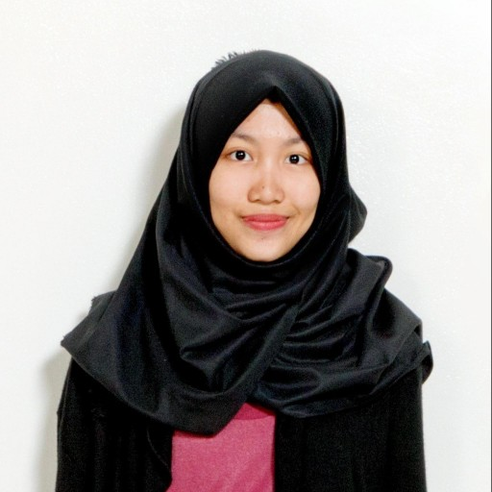
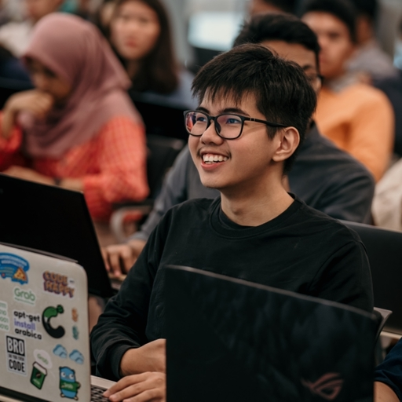
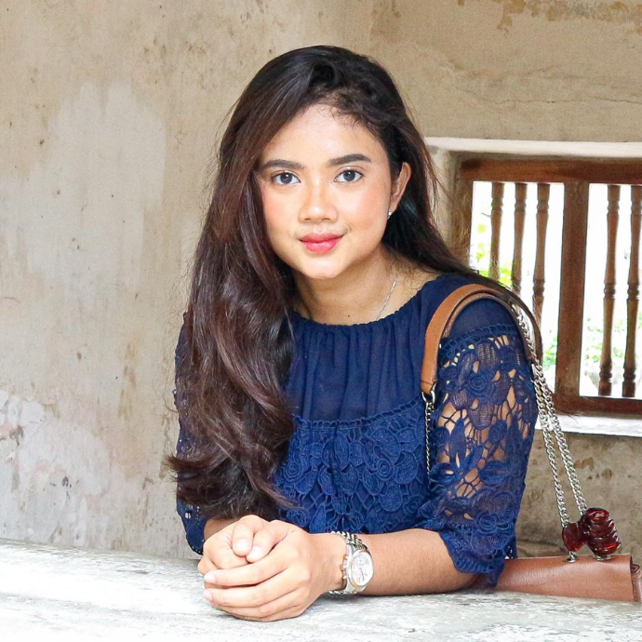
Riceye
Thank You~
Rike Adelia
Hansel Susanto
Brizky Ramadhani

